Slide 1
Creating a Dementia Friendly County 11th March 2021

Slide 2
A Presentation to The Suffolk Health and Well-Being Board
Sue Hughes (Suffolk and North East Essex Dementia Forum)
Lynden Jackson (The Debenham Project)
Caroline Manning (Family Carer)
Rachael Coombs (Suffolk County Council, Adult Care)

Slide 3
Sue Hughes
Summary of the paper
and
Ask of the Board

Slide 4
Sue Hughes

Slide 5
Lynden Jackson
Experiences of leading a Dementia Friendly Community

Slide 6
Make it Local
Make it Simple
Make it Work

Slide 7
Basic Statistics
2019 - 2020
12 Years to Date
8,500 Catchment Population
120 Volunteers
100 “Families” living with Dementia
65% Contact Success
250 pm Person Sessions of Support
£8,500 pa Cost

Slide 8
Value for Money?
£1 pa per head of Pop.
(0.07% of total cost of health and care for the elderly)
£100 pa per family living with dementia
£3.50 per person session
2% of Normalised Local Spend on Dementia Social Care

Slide 9
Potential Savings
£650+ per person pw in Delayed or Avoided Residential Care Places
£2500+ per person pw in reduced Hospital Bed Blocking
£200+ per person pw week in reduced domiciliary Care

Slide 10
+
Improved Physical, Psychological, and Emotional Well-Being (Quality of Life) for 45 Current Carers, 25 Past Carers, 40 Cared-For and 40 Other Frail Elderly Persons

Slide 11
The Debenham Project (Dementia – Caring for the Carers)
Understanding
Helpful
Supporting
Active
(A Dementia Friendly Community)

Slide 12
Make it Local
Make it Simple
Make it Work

Slide 13
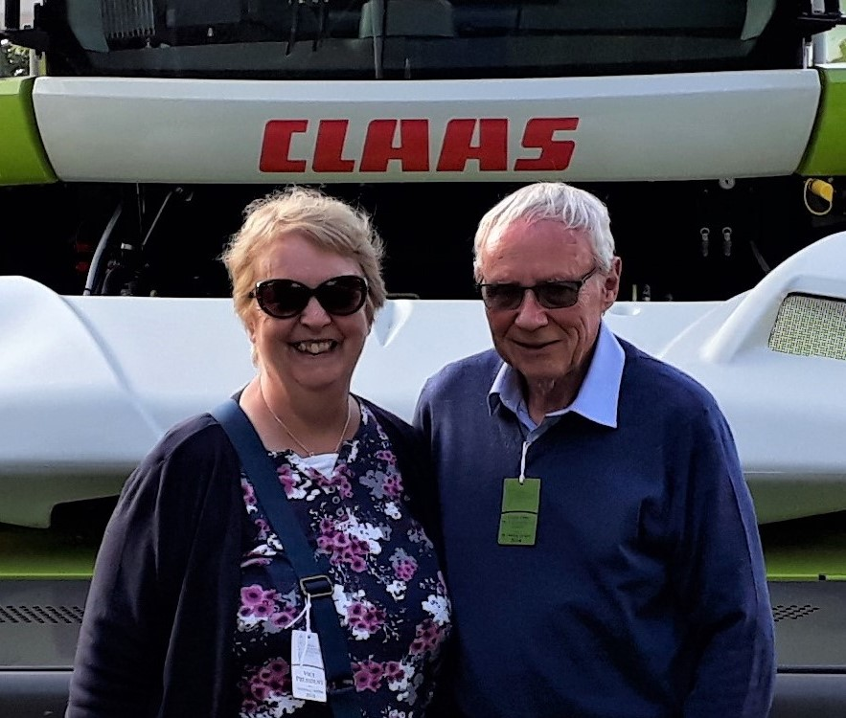
Caroline Manning
The benefits of a Dementia Friendly Community – A User / Carer Perspective

Slide 14
Caroline Manning

Slide 15
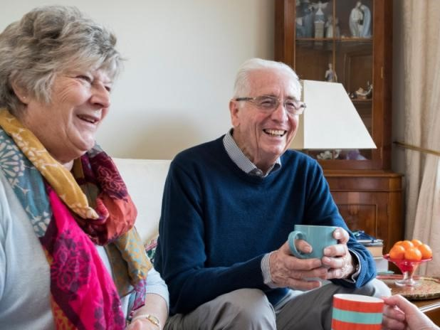
Rachael Coombs
Summary

Slide 16
Creating a Dementia Friendly County Suffolk Health and Wellbeing Board (H&WBB) 11th March 2021
Presented by the Suffolk and North East Essex (SNEE) Dementia Forum

Slide 17
What is the ask of the H&WBB?
Build on the 2015 commitment to create a dementia friendly county in Suffolk
Agree to the proposed shared vision:
“People living with dementia and their carers’ in Suffolk will have the best opportunities to be safe and well and continue to live an active life of their choosing, within an informed community that supports, includes and values them”
For each organisation to consider:
“What would make the most impact / difference to supporting people with dementia and their carers?” within their own organisational context (ideas via LGA’s dementia friendly community framework)
Whether they can sign up to become a dementia friendly organisation by March 2022
What opportunities are there to work alongside communities, as supporters or sponsors of dementia friendly communities?
How to support communities to access sustainable funding based upon their demonstrated impact in championing dementia friendly support
How best to ensure progress against identified actions – within their own organisations and collectively?

Slide 18
Why are dementia friendly communities important?
Dementia friendly and supportive communities help people living with dementia and their carers live with greater safety, independence and wellbeing
For statutory organisations, we know that the expected demographic of people living with dementia will significantly increase over the 20 years to be nearly double (estimated 23,000 by 2040 in Suffolk), with an associated increase in the number of carers supporting these individuals
We need to act now and take a more radical, proactive approach to reduce the costs personally to people living with dementia and their carers, and financially system-wide

Slide 19
What needs to happen next to take this forward?
The H&WBB to:
Act as project sponsors in supporting Suffolk to become a “Dementia Friendly County”
Put in place appropriate governance to maintain oversight of identified actions and progress – examples include setting up a Dementia Friendly Suffolk Board or Pan-Suffolk Dementia Action Alliance
Support the delivery and oversight of a county action plan, with milestones and measurable objectives to be achieved over the next 12 months
Proposal for how this can be achieved:
Georgia Chimbani (ACS Director) to chair an initial meeting of member organisations before the next H&WBB in July to discuss the way forward, including potential individual and collective actions
Update given at the next H&WBB

